Slide 1
Face Mask Detection Using Machine Learning
JATIN CHAUHAN 22MCA20129

Slide 2
CONTENT
Introduction
Motivation
Innovation of Project
Scope of the Project
Open-CV Python
Face Detection
Result
Conclusion

Slide 3
Introduction
Face detection is a computer vision technology that helps to locate/visualize human faces in digital images. This technique is a specific use case of object detection technology that deals with detecting instances of semantic objects of a certain class (such as humans, buildings or cars) in digital images and videos. With the advent of technology, face detection has gained a lot of importance especially in fields like photography, security, and marketing.

Slide 4
Motivation
Amid the COVID-19 pandemic, there are no efficient face mask detection applications which are now in high demand for transportation means, densely populated areas, residential districts, large-scale manufacturers and other enterprises to ensure safety. The absence of large datasets of ‘with_mask’ images has made this task cumbersome and challenging.

Slide 5
Innovation Idea of Project
It can Detect faces easily with less time of execution.
It can Detect Face in any quality of Images even blur.
It can Detect single, double or even multiple faces in any Image.
It can tell the number of Peoples/faces in Image.
It is fully automatic face recognition system
It is one of the best in today world Innovation as per less number of code use in the system.
It use Haar feature based Algorithm to detect which it makes very accurate and fast processing of face detection

Slide 6
Scope of Project
The face mask detection project aims to develop a system capable of detecting whether individuals are wearing masks in real-time. The project will begin with collecting a diverse dataset of images and videos depicting people with and without masks. This data will then be preprocessed to ensure it is suitable for training the machine learning model. A suitable model, such as a Convolutional Neural Network (CNN), will be selected and trained using the preprocessed dataset to enable it to learn and make accurate predictions. The performance of the trained model will be evaluated using various metrics to assess its effectiveness. The final model will be integrated into a real-time system or application that can process live streams or images from cameras.
The system will include a user-friendly interface to display the results of face mask detection, highlighting individuals without masks and generating alerts when non-compliance is detected. Privacy and ethical considerations will be taken into account to ensure compliance with regulations and respect individuals' privacy rights. The deployed system will undergo extensive testing in real-world environments to validate its accuracy and reliability. Ongoing maintenance and updates will be planned to address any issues and incorporate improvements as needed, keeping the system up-to-date and effective.

Slide 7
OpenCV-Python
OpenCV essentially stands for Open Source Computer Vision Library. Although it is written in optimized C/C++, it has interfaces for Python and Java along with C++. OpenCV boasts of an active user base all over the world with its use increasing day by day due to the surge in computer vision applications.
OpenCV-Python is the python API for OpenCV. You can think of it as a python wrapper around the C++ implementation of OpenCV. OpenCV-Python is not only fast (since the background consists of code written in C/C++ but is also easy to code and deploy(due to the Python wrapper in foreground). This makes it a great choice to perform computationally intensive programs.

Slide 8
Installation
OpenCV-Python supports all the leading platforms like Mac OS, Linux, and Windows. It can be
installed in either of the following ways:
Packages for standard desktop environments (Windows, macOS, almost any GNU/Linux distribution)
run pip install opencv-python if you need only main modules
run pip install opencv-contrib-python if you need both main and contrib modules

Slide 9
Face Detection
Face detection is a technique that identifies or locates human faces in digital images. A typical example of face detection occurs when we take photographs through our smartphones, and it instantly detects faces in the picture.
Face detection is different from Face recognition. Face detection detects merely the presence of faces in an image while facial recognition involves identifying whose face it is. In this article, we shall only be dealing with the former.
Face recognition is the task of identifying an already detected object as a known or unknown face. Often the problem of face recognition is confused with the problem of face detection Face Recognition on the other hand is to decide if the "face" is someone known, or unknown, using for this purpose a database of faces in order to validate this input face.

Slide 10
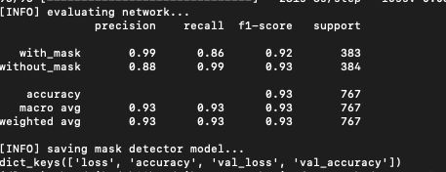
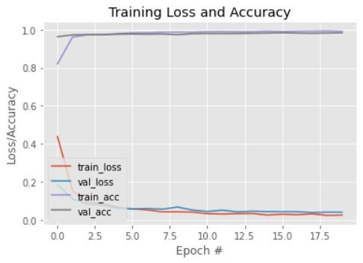
Result
Our model gave 98% accuracy for Face Mask Detection after training via tensorflow-gpu==2.5.0
We got the following accuracy/loss training curve plot

Slide 11
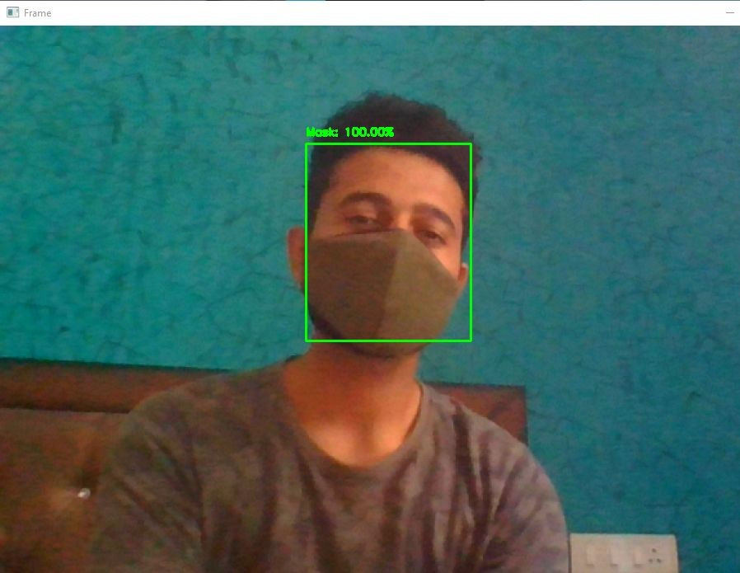
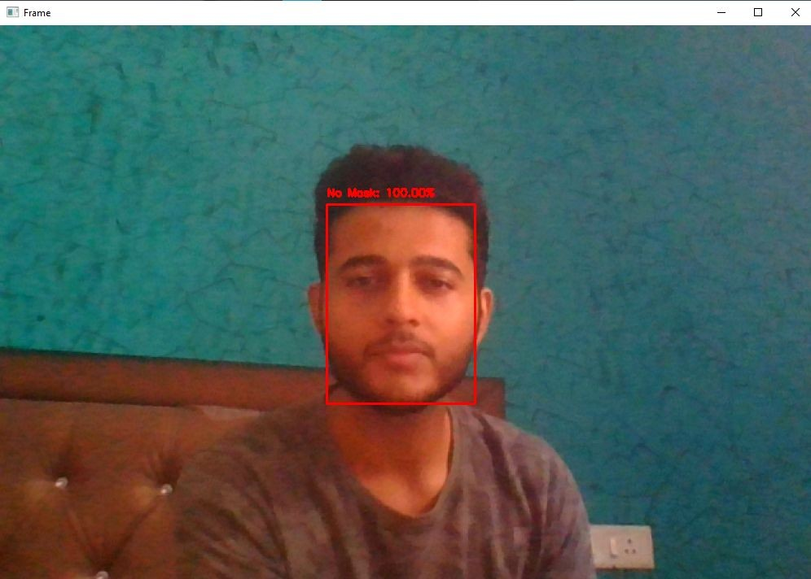
Sample Outputs

Slide 12
Conclusion
Face recognition technologies have been associated generally with very costly top secure applications. Today the core technologies have evolved and the cost of equipments is going down dramatically due to the integration and the increasing processing power. Certain applications of face recognition technology are now cost effective, reliable and highly accurate. As a result there are no technological or financial barriers for stepping from the pilot project to widespread deployment. Government and NGOs should concentrate and promote applications of facial recognition system in India in various fields by giving economical support and appreciation.

